Slide 1

Note:
Please view in slide show mode
Usually found bottom right of screen
This power point has animation effects and will not display properly unless viewed in slide mode. If you have any questions please do not hesitate to contact me.
Thank you
Te Tuhi
Learning Experiences Outside the Classroom
Ph: 09 577 0138
info@tetuhi.art

Slide 2
Welcome
Thank you for using this pre-visit resource.
We believe this will help strengthen student learning leading up to and during your gallery visit.

Slide 3
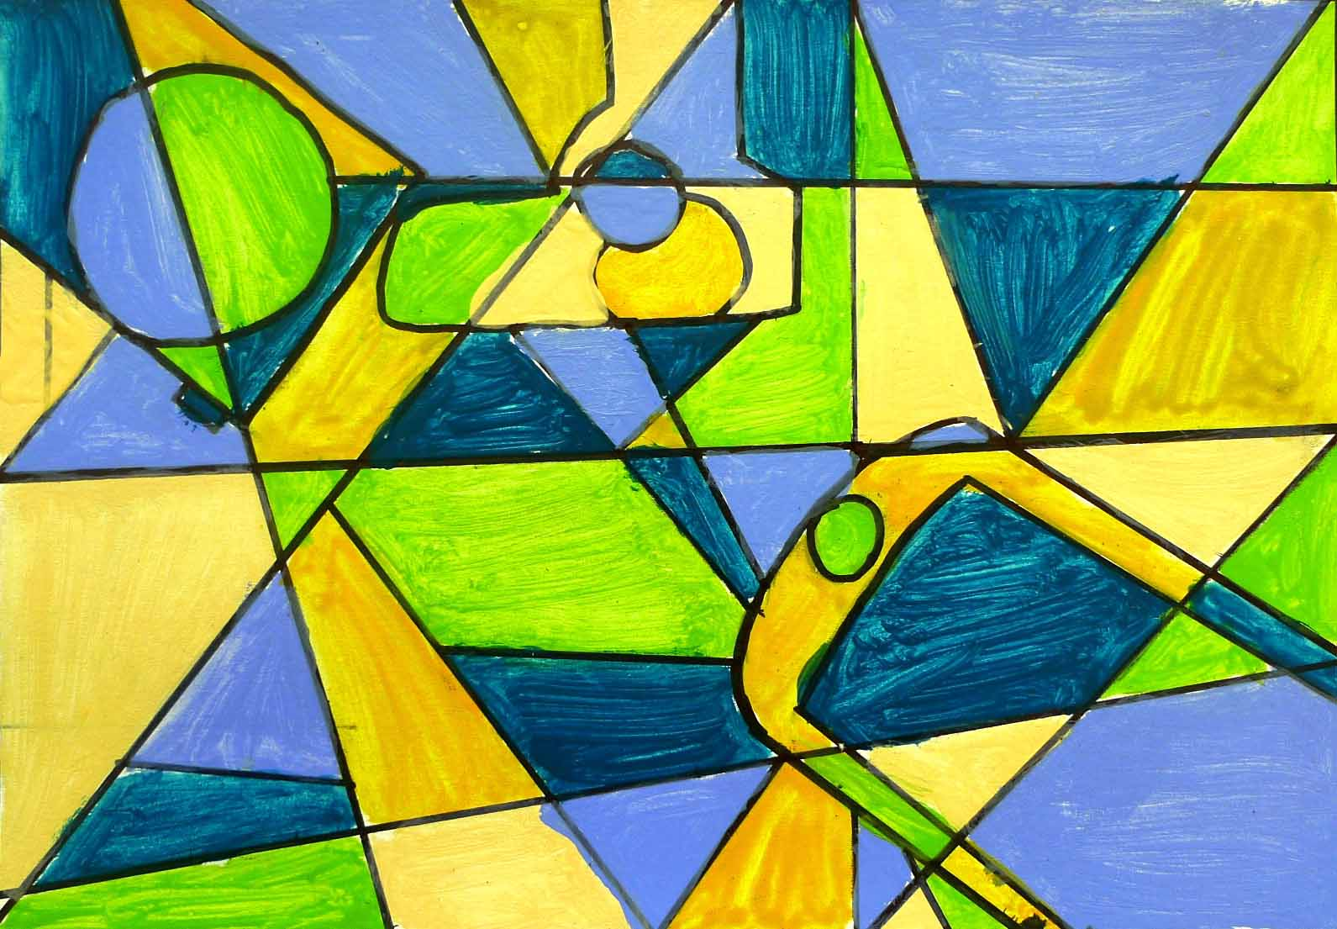
NOW LOADING…
Te Tuhi pre visit: Lesson 1

Slide 4
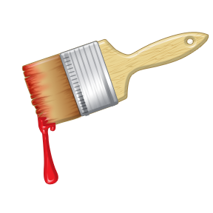
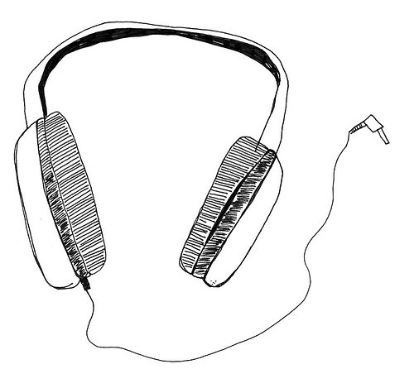
Welcome to now loading
During the next few lessons we will explore…
What abstract painting can look like
How to make something Abstract
The kinds of technology people use
Image: http://findicons.com/icon/69366/close_box_red

Slide 5
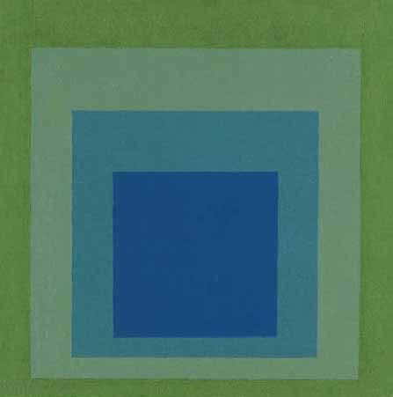
Let’s begin lesson by exploring what abstract painting can look like…
Image; http://www.artquotes.net/masters/josef-albers/untitled.htm

Slide 6
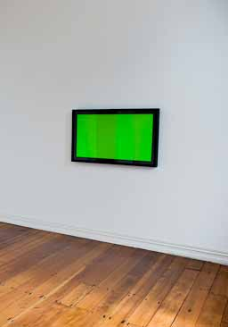
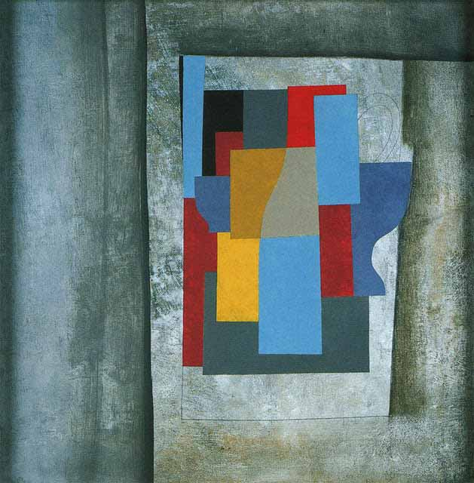
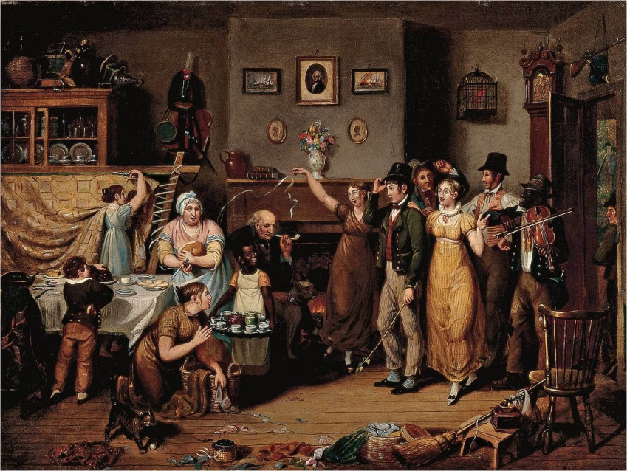
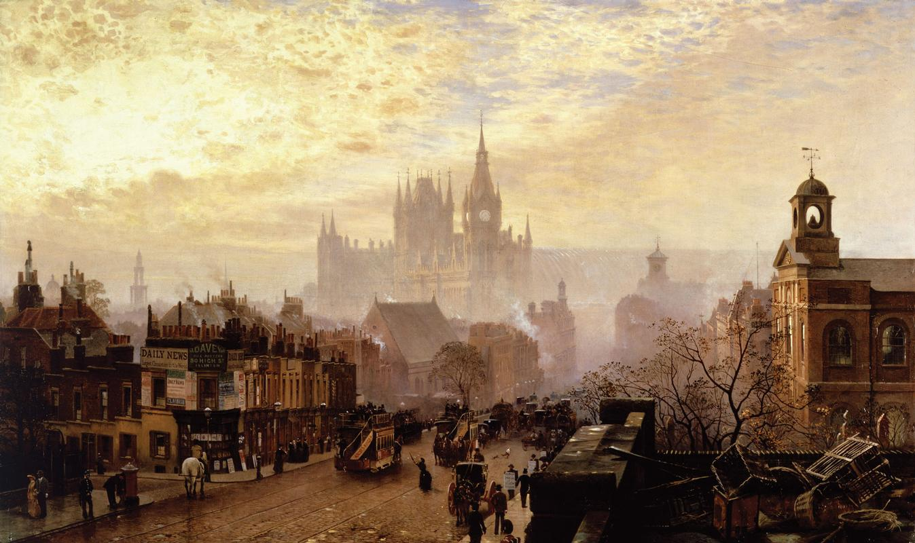
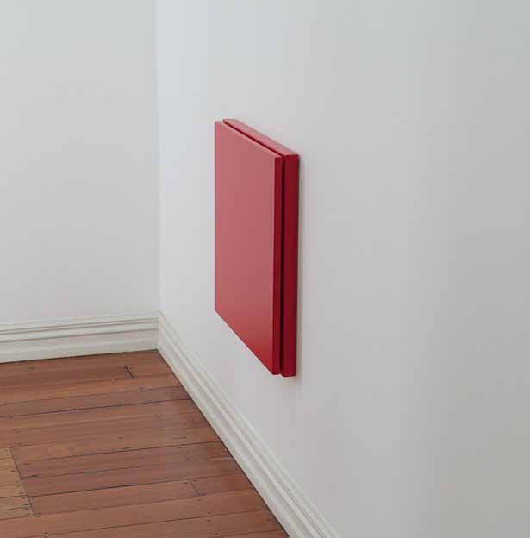
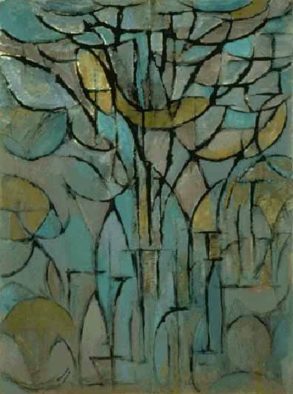
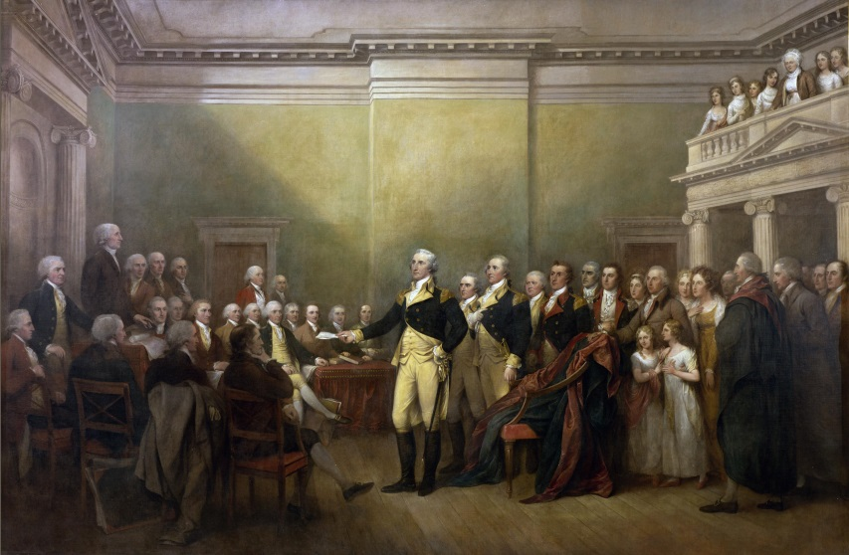
Abstract Painting
Abstract painting started many years ago during the early 19th century.
During this time artists were creating paintings that were realistic. Abstract artists did not want to paint this way and so started painting with shapes and colour.
They would paint people, animals and places using different shapes and colours to show the world in a different way.
Image:
https://artjournalcompost.wordpress.com/page/2/
http://www.thinglink.com/scene/588362094638792705
http://www.matthenryinfo.com/014.html http://www.matthenryinfo.com/017.html
http://emptyeasel.com/2007/04/17/piet-mondrian-the-evolution-of-pure-abstract-paintings/

Slide 7
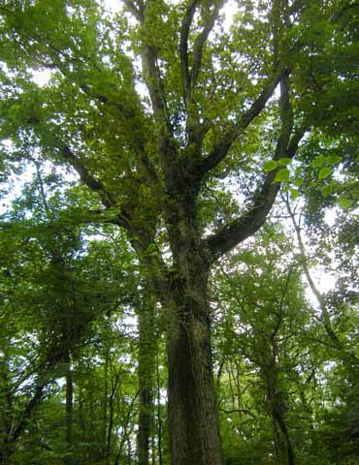
Abstract Painting
Let’s see what artist Piet Mondrian has painted…
By using shapes and colour an abstract painting can often disguise an object or the person the artist has painted.
The lines and curves in the painting reflect those of the tree while the colours painted relfect that of the leaves, branch and trunk of the tree.
But if we look carefully there might be clues as to what the artist has painted under all shapes and colour.
Looking at the lines, shapes and colours in this painting what could the artist be disguising?
Let’s take a look at another abstract painting…
Image:
http://emptyeasel.com/2007/04/17/piet-mondrian-the-evolution-of-pure-abstract-paintings/
http://www.nhm.ac.uk/visit-us/galleries/green-zone/treasures/tree-installation/hightlights-slideshow/index.html

Slide 8
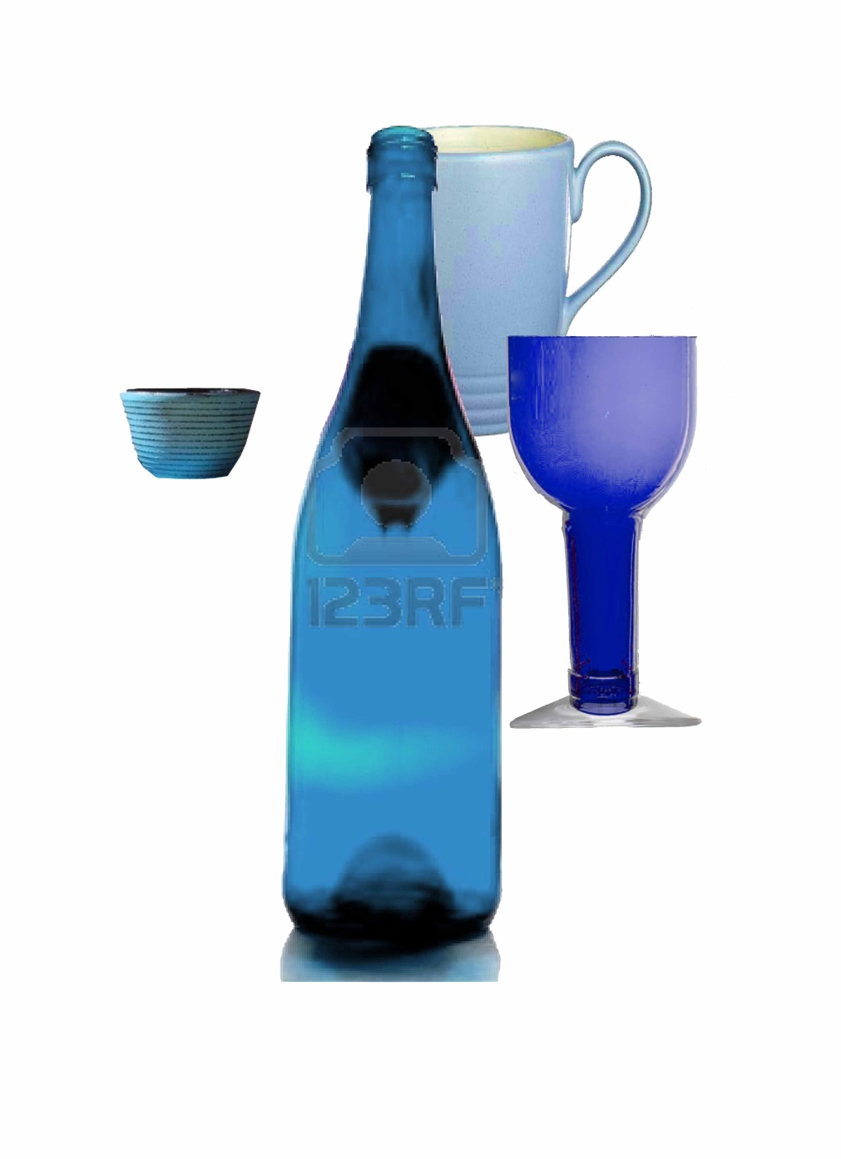
Abstract Painting
Let’s start by carefully looking at the shapes in this painting?
Are there any shapes that remind us of particular objects?
Lines, shape and colour reflect the cups and bottle in this painting.
Artist Ben Nicholson has disguised his objects well by overlaying lots of shapes and colour in different places.
There appear to be 4 shapes that look like familiar things. Can you see them?
Let’s look at another abstract painting…
Lets take a look…
Image:
https://www.flickr.com/photos/gandalfsgallery/12202866603/
http://www.123rf.com/photo_3361305_glass-of-red-wine-and-blue-bottle-on-white.html
http://www.palmerstores.com/product/jamie-oliver-fluted-blue-light-mug/1431/
http://kidglasa.info/prescription-glasses-buy-one-get-one-free/

Slide 9
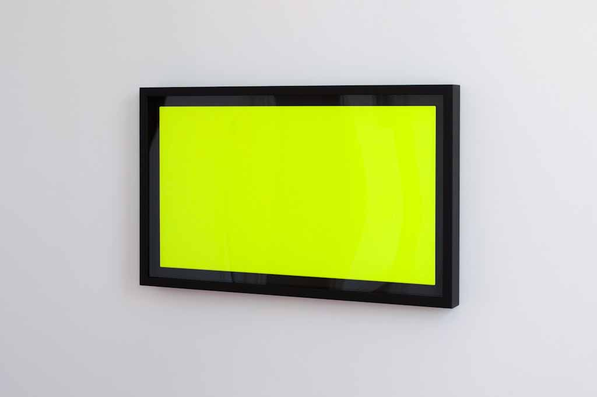
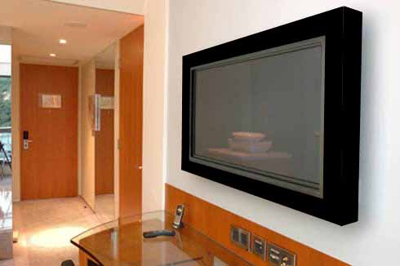
Abstract Painting
Abstract painting can also use shape, colour and size to look almost the same as something else.
What things have made this painting look like a television?
The black colour and glass of the frame, the bright green screen, its size and being attached to the wall have helped make this painting look like an actual television.
What might we see in this image?
We see what looks like a television on a wall.
Let’s look at more abstract paintings that use shape, colour and size.
Here is an image of an actual television on a wall.
Image:
http://starkwhite.blogspot.co.nz/2011_04_01_archive.html
http://freshome.com/2009/06/01/wall-mounted-lcd-and-plasma-tv-frames-by-hd-envy/

Slide 10
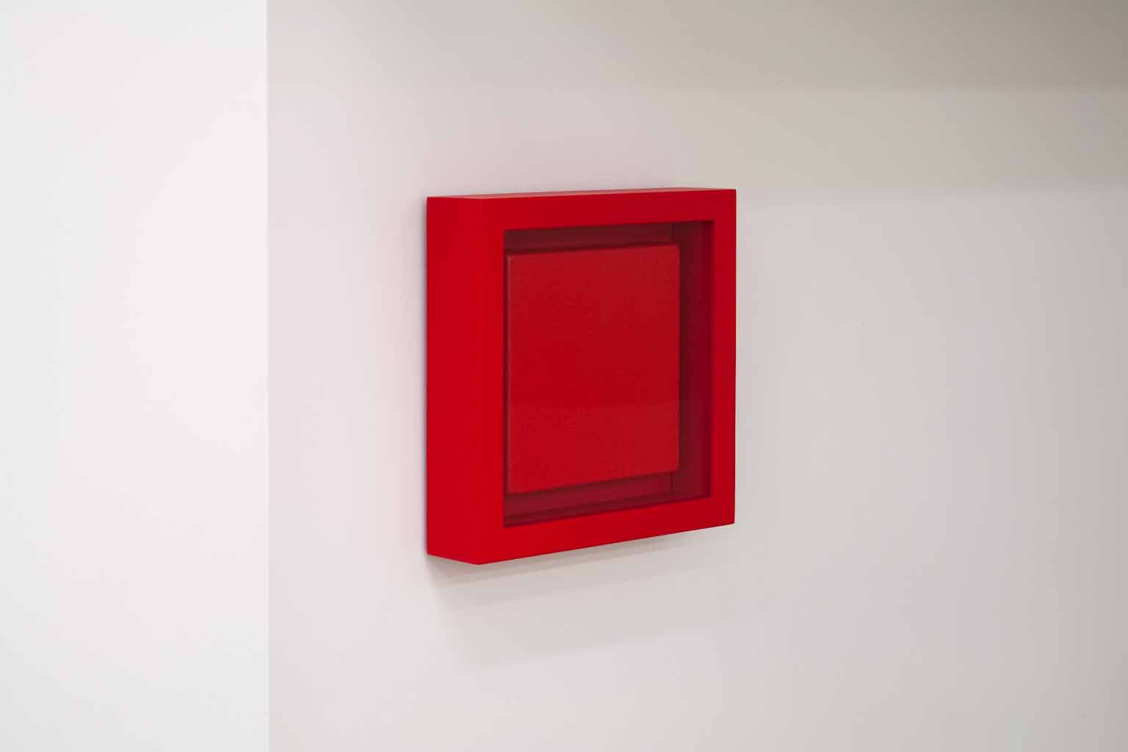
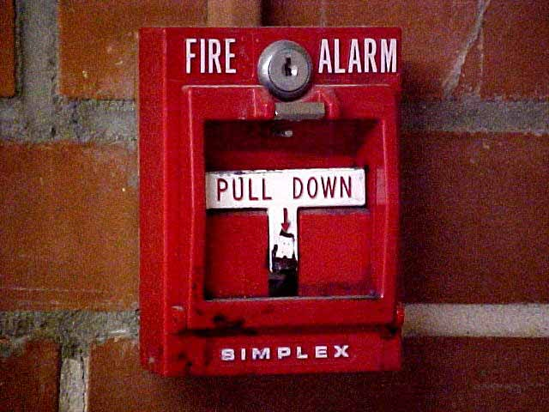
Abstract Painting
Let’s start by looking at the colour of this framed painting. What colour has the artist used in this painting?
What things have made this painting look like a fire alarm switch?
The painted frame, colour red, small size and being attached to the wall has helped make this painting look like a fire alarm switch.
What size do you think this painting is? Does this painting appear big or small?
Could this painting be of an object that is small? A kind of switch perhaps?
Let’s take a look at one more abstract painting that uses shape, colour and size.
What objects can we think of that look like this painting?
Let’s take a look…
Image:
http://www.matthenryinfo.com/012.html
http://weltuk.com/FIRE-ALARMS

Slide 11
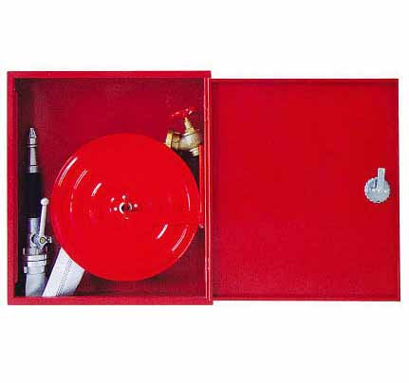
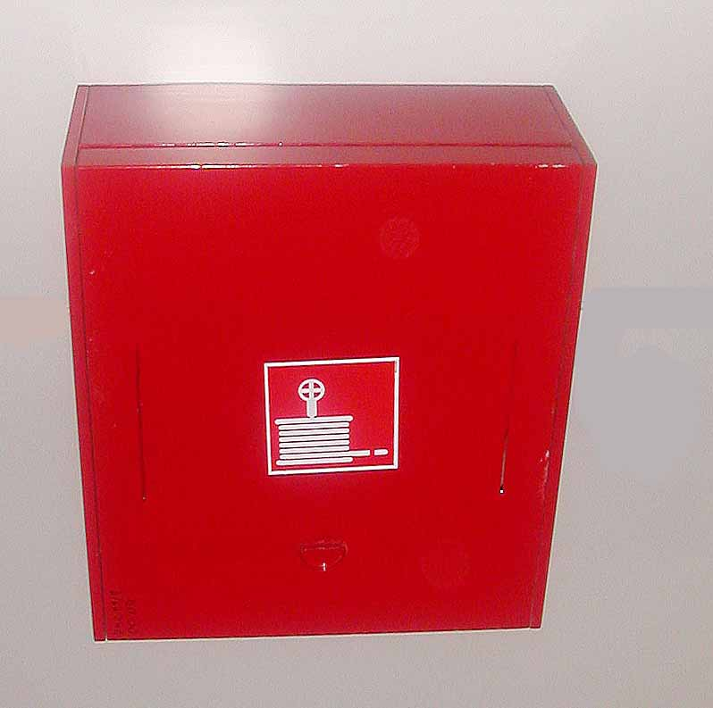
Abstract Painting
Let’s start by looking at the size of this painting. Does this painting look big or small?
What things have made this painting look like a fire hose cupboard?
How high is this painting hung on the wall? What colour has the artist used?
The top canvas appearing as a door, the colour red, large size and being attached to the wall at waist height has helped make this painting look like a fire hose cupboard.
What things can we think of that look like this painting and could be attached to a wall at this height?
Let’s take a look…
Image:
http://www.matthenryinfo.com/017.html
http://www.ecvv.com/product/762167.html

Slide 12
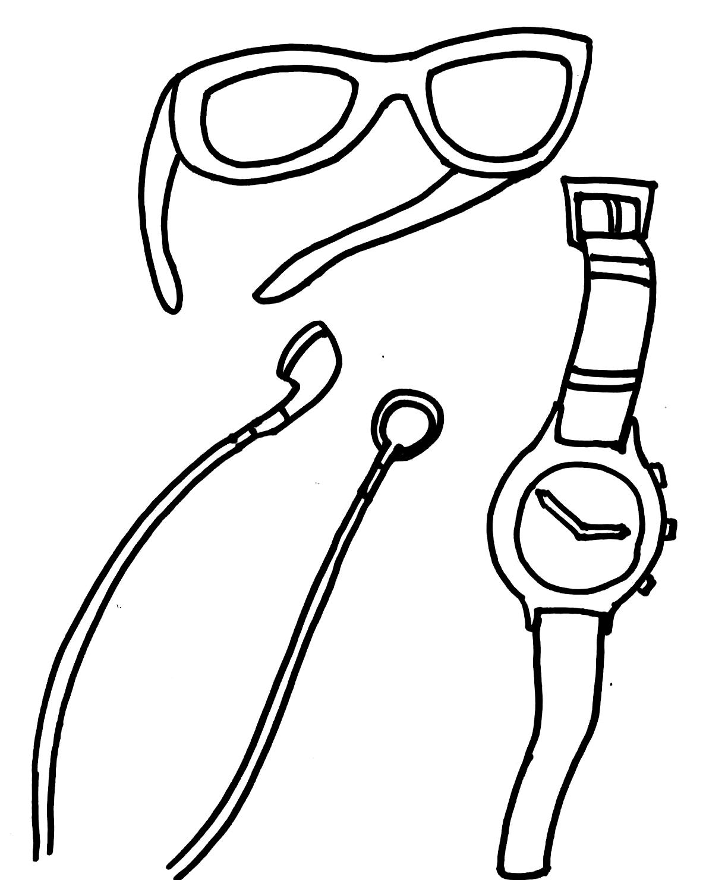
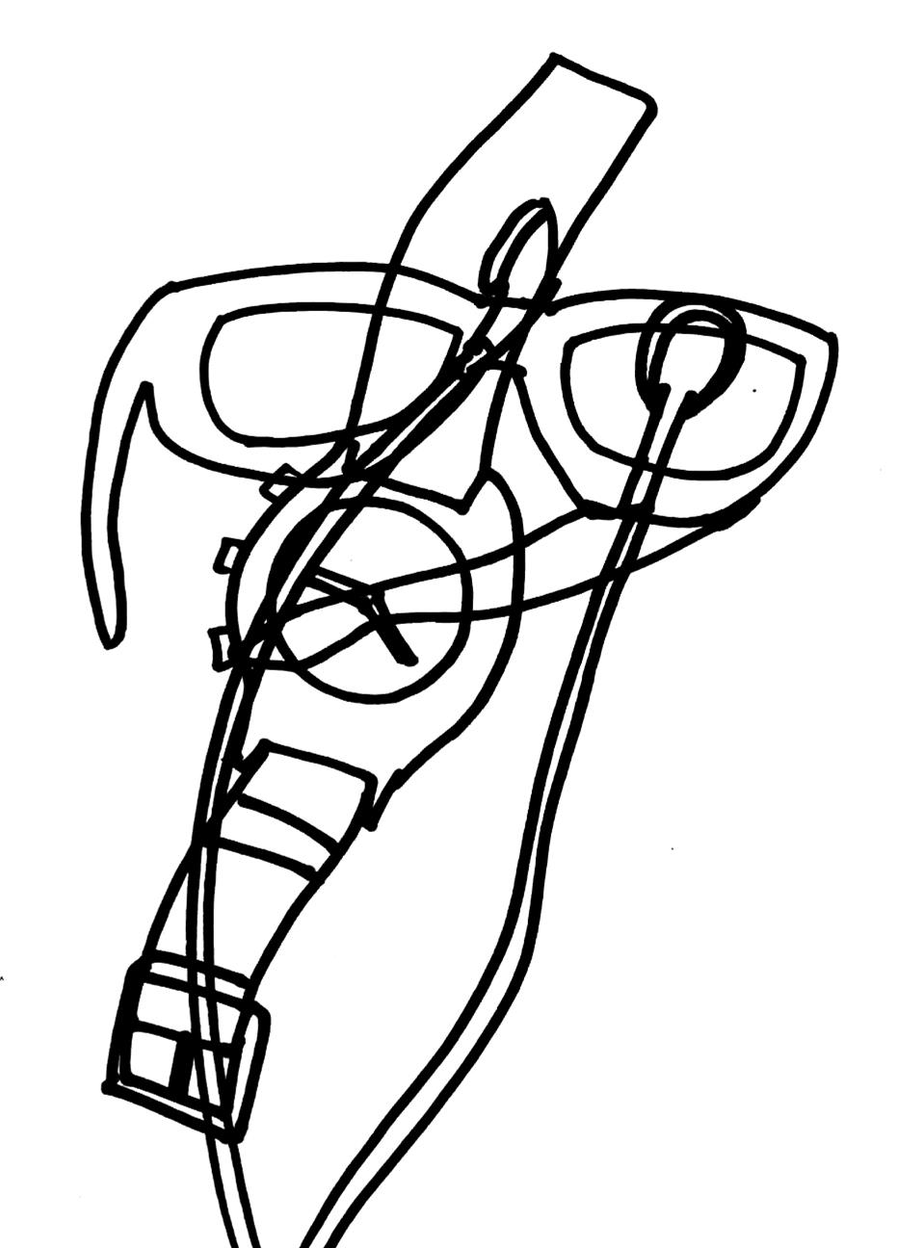
Matt Henry
Activity
The artist behind these three artworks is NZ artist Matt Henry.
As we can see, Matt’s paintings focus on colour, shape, size and height of the object.
Using this style of painting trace 3 objects from home or in the classroom. This will give you an accurate size and shape.
Try to overlap your drawings and add shapes to help disguise your objects.
Image:
http://www.myonlineruler.com/
http://www.socialstrategy1.com/2011/04/11/data-drives-social-media-success/
http://www.schooluniformshop.co.uk/product.php/342/36/helix-metal-compass-and-pencil-set
http://thespiritualcoach.com/2010/09/do-you-measure-up-spiritually/measuring-tools-05/
http://www.fredshead.info/2006/12/measuring-tools-for-blind-using.html
http://virtualmathtutor.blogspot.co.nz/2010/11/how-to-draw-circle-without-compass.html

Slide 13
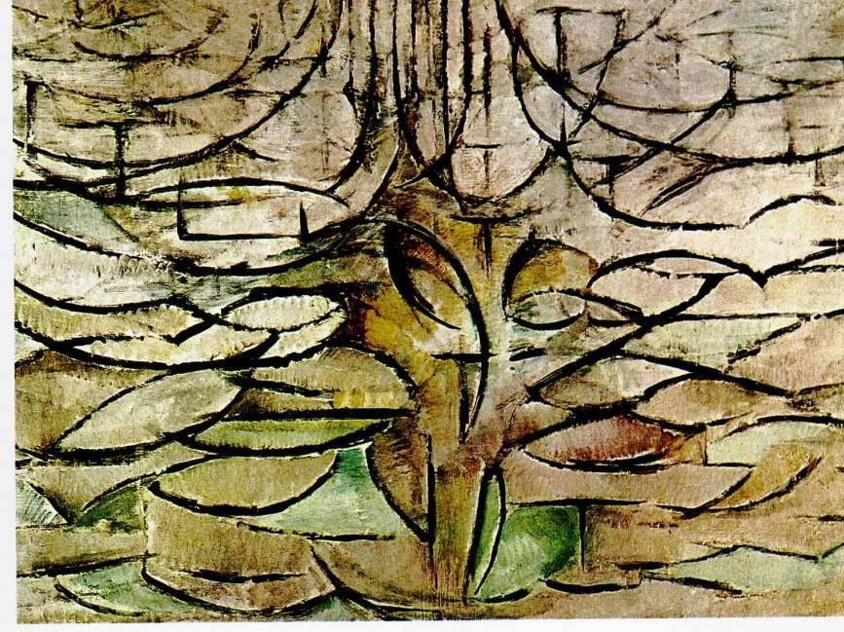
Now that we know what abstract painting
can look like…
Let’s recap on what we have learnt so far…

Slide 14


So what have we learnt so far?
Abstract painting…
started because abstract painters wanted to show the world in a different way.
combines line, shape, colour and overlaying to help disguise objects and show them in a different light.
can be inspired by objects in shape, colour and size just like Matt Henry’s paintings.

Slide 15
In the next lesson we will explore “how to make something abstract”
End of lesson
End of lesson.

